Slide 1

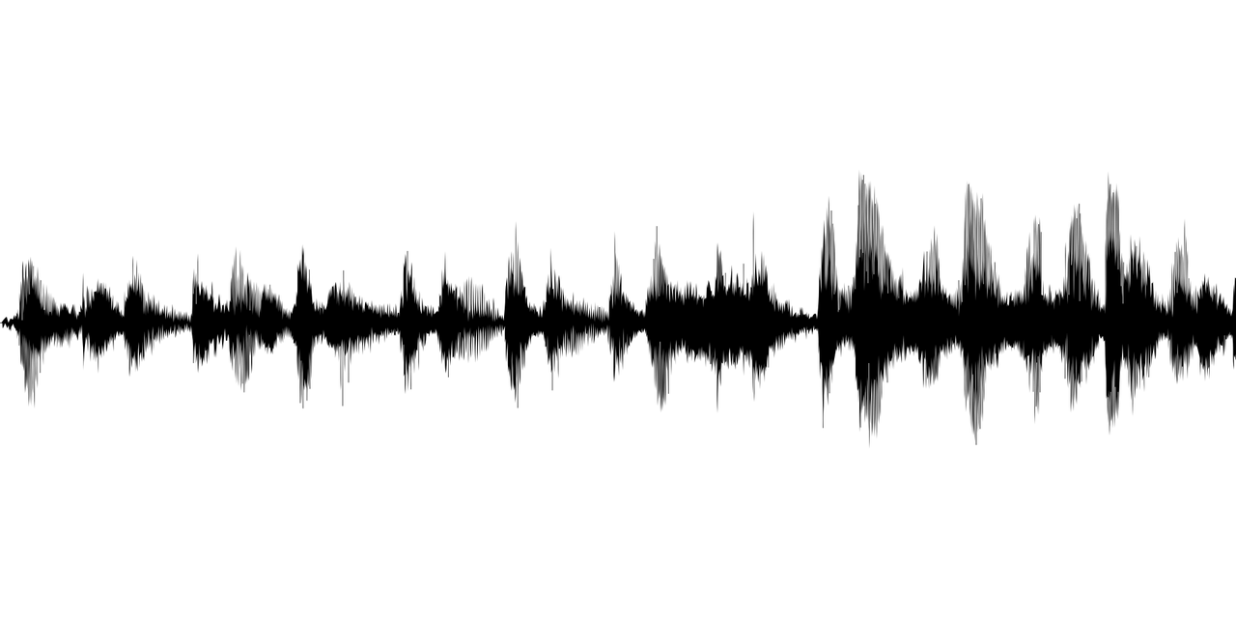

Team C: Fast Fourier Transform Aiden, Adam, Leigh

Slide 2
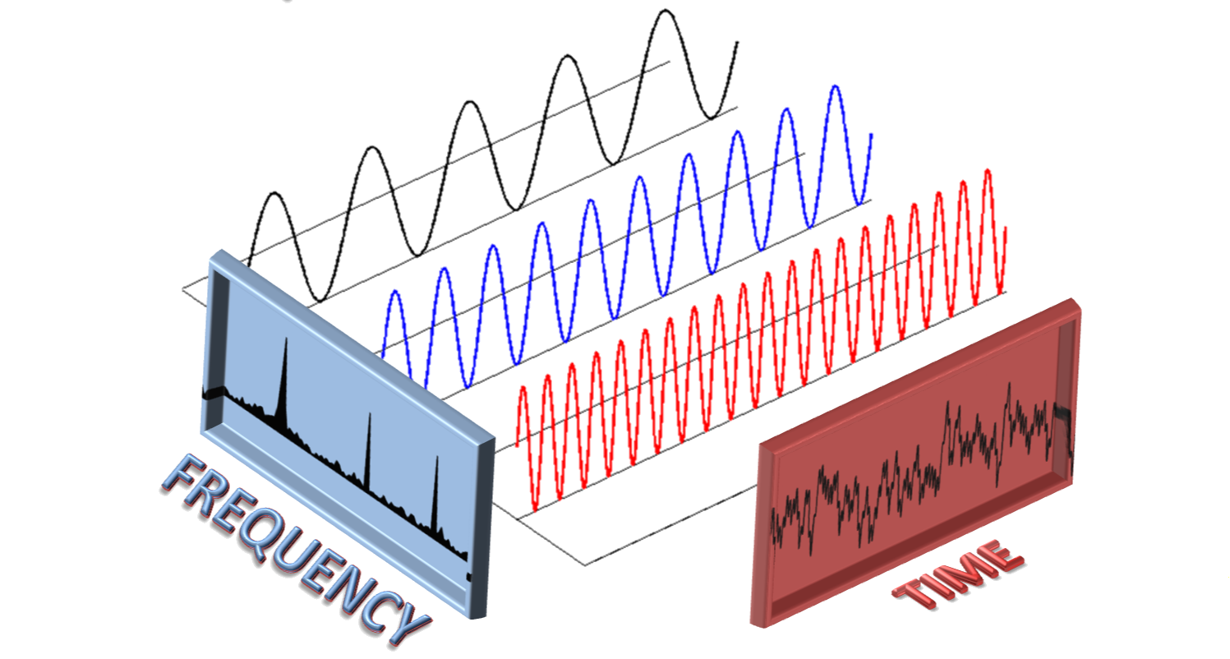
Our Algorithm:
Fast Fourier Transform

Slide 3
Fast Fourier Transform
Overview
Optimize on DFT using the divide and conquer method
Problem Solved
DFT computation is too slow for large datasets
Notes:
Leigh
Overview: The FFT efficiently computes the Discrete Fourier Transform (DFT) by breaking it into smaller DFTs and using symmetry to reduce redundant calculations.
It lowers complexity from O(N²) to O(N log N).
Problem Solved: Direct computation of the DFT is too slow for large datasets.
FFT makes frequency analysis feasible for real-time applications in fields like signal processing, image analysis, and more.

Slide 4
Examples
Audio Signal Analysis
Usage: Noise Reduction and Equalization
Explanation: Convert audio signals into frequencies
Image Compression
Usage: Compress images to reduce the file size
Explanation: Break down pixel values into frequency components
Notes:
Leigh
Key Examples:
Audio Signal Analysis: Converts time-domain data into frequencies for noise reduction or equalization.
2. Image Compression (e.g., JPEG): isolate key frequency data for encoding, resulting in efficient file storage
Explanation of Examples:
By decomposing signals into frequency components, FFT significantly accelerates computations compared to the direct DFT method, making real-time processing feasible.

Slide 5
Background
History
1960s DFT Developed
1965 FFT formalized by Cooley and Tukey
Similar Algorithms
DFT Basis for FFT
Wavelet Transform Also used for time frequency analysis, but different purpose
Notes:
Leigh
Background Information:
Popularized by Cooley and Tukey in 1965.
makes frequency domain analysis practical for large datasets.
Key Innovation:
FFT reduces the complexity of the Discrete Fourier Transform (DFT) from O(n^2) to O(n log n).
through the computing revolution of the next decade, made FFT one of the indispensable algorithms in digital signal processing.
Comparison with Similar Algorithms:
Direct DFT: Slower due to its higher complexity.
Wavelet Transform: Focuses on time-frequency analysis but differs in purposes

Slide 6
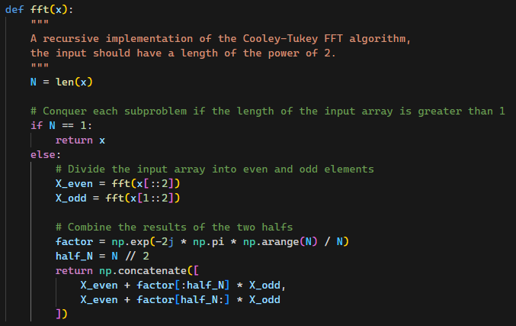
How it Works
Recursive algorithm
Divides input series into two series, split on the even/odd indices.
Computes the "twiddle factors" of an input series
Combines the twiddle factor computed series into one series.
Notes:
Adam

Slide 7
Discussion
Benefits
Efficiency
Real-Time Processing
Wide Use
Drawbacks
Time-Domain Loss
Input Size
Notes:
Leigh
Advantages:
Efficiency: FFT reduces time complexity from O(n²) to O(n log n)
Real-Time Processing: Because it is computationally efficient, it can be used for real time processing, even for large datasets
Wide Use: Common in scientific and engineering fields for spectral analysis and filtering.
Disadvantages:
Input Size: Requires input size to be a power of 2 for optimal performance. zero-padding adds overhead.
Time-Domain Loss: Loses time-domain information, making it unsuitable for non-stationary signals.
Precision: Floating-point errors may occur, affecting accuracy.

Slide 8
Comparison
FFT
Complexity: O(n log n)
Usage: General-purpose frequency analysis, especially with large datasets.
DFT
Complexity: O(n²)
Usage: Suitable for small datasets
Goertzel
Complexity: O(n) (for specific frequencies)
Usage: Suitable for a small range of frequencies
vs
Notes:
Leigh

Slide 9

Entrepreneurial Pitch
What is Big Brain Coin and how can it make money?
Notes:
Aiden
Do you consider yourself big brained?
Do you consider yourself an intellectual?
Calling out to all influencers, podcast bros and anyone else big brained enough to realize the massive benefits that Big Brain Coin can bring to you

Slide 10

bbcoin
BBCoin is a new meme coin developed using a Fast Fourier Transform
Faster
Funner
Decentralized
Encrypted
Bigger Brained
Notes:
Aiden
BBCoin is a revolutionary new meme coin that you can invest in today
It is: - Faster
Funner
Decentralized
Encrypted using Fast Fourier Transform
And best of all, BIGGER BRAINED

Slide 11
how is fft used?
Used within the key generation, encryption, and decryption methods
- Used in place of standard RSA encryption techniques
- Current implementation is not 100% secure, however there are papers which help lend to the idea of this working.
Plaintext
Ciphertext
FFT + Standard Encryption Techniques
Source: https://arxiv.org/pdf/1810.07177

Slide 12
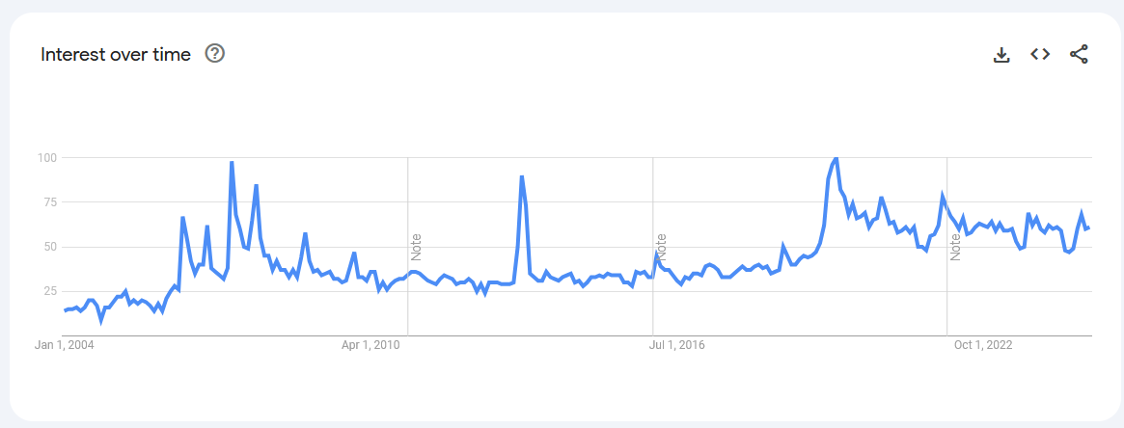

Market Research
Target Audience: Social Media, Content Creators, Streamers, etc.
The search for "Big Brain" has been on a slight steady upward trend overtime
Memecoin sector is "exploding" with interest over 2024*
Recently grew to a market cap of $117.28B (+$93B)
Scandals like the recent $HAWK scandal highlight the volatility of the sector.
Key Takeaways:
Large and growing industry & sector
Large amounts of money available
Highly volatile, subject to media influence.
Image Source: Google Trends
*: https://news.bitcoin.com/meme-coins-take-2024-by-storm-sector-explodes-with-93-billion-growth/
Notes:
Adam

Slide 13








Business Plan
79k
Start with 21% of the coins in known pool
Sell 5% to investors as an initial market fund, with an additional 2:1 gift for 10% to investors
The initial value of a coin is equal to initial fund spread over all the coins in circulation
+
10k
1k
-
+
10k
Buy $1
= $0.45
2x
Notes:
Aiden

Slide 14

Would you invest?
Team C

Slide 15
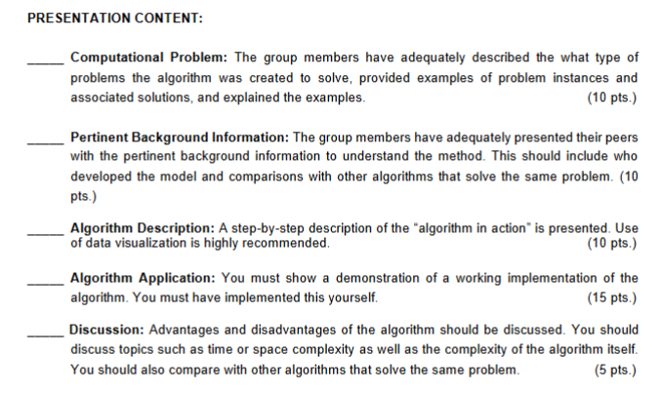

Slide 16
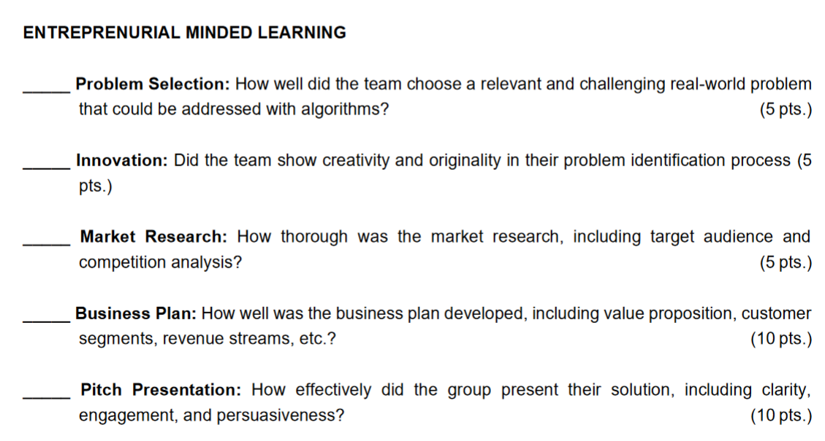

Slide 17
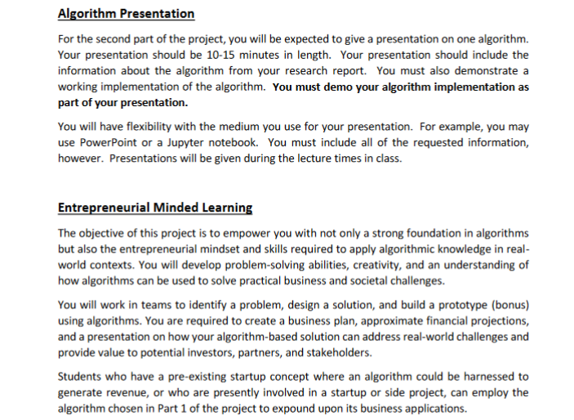

Slide 18
Dynamic delivery​
Learn to infuse energy into your delivery to leave a lasting impression​
One of the goals of effective communication is to motivate your audience
Metric​ | Measurement​ | Target​ | Actual​
Audience attendance​ | # of attendees​ | 150​ | 120​
Engagement duration​ | Minutes​ | 60​ | 75​
Q&A interaction​ | # of questions​ | 10​ | 15​
Positive feedback​ | Percentage (%)​ | 90​ | 95​

Slide 19
Speaking engagement metrics​
Impact factor​ | Measurement​ | Target​ | Achieved​
Audience interaction​ | Percentage (%)​ | 85​ | 88​
Knowledge retention​ | Percentage (%)​ | 75​ | 80​
Post-presentation surveys​ | Average rating​ | 4.2​ | 4.5​
Referral rate​ | Percentage (%)​ | 10​ | 12​

